Slide 1

Bluebirds Ability
Ideas for Inclusive Sport Sessions
Including participants with sensory issues

Slide 2

Including players with sensory issues
Autism Spectrum Disorder is a common condition
It is referred to as a spectrum because it affects people in different ways
1 in 100 people are on the autism spectrum
Autistic people may be over or under sensitive to sensory stimulus e.g. noise, touch, light, temperature or pain
When planning and delivering sport or exercise, it is important to know about your participant’s needs and how to accommodate them

Slide 3
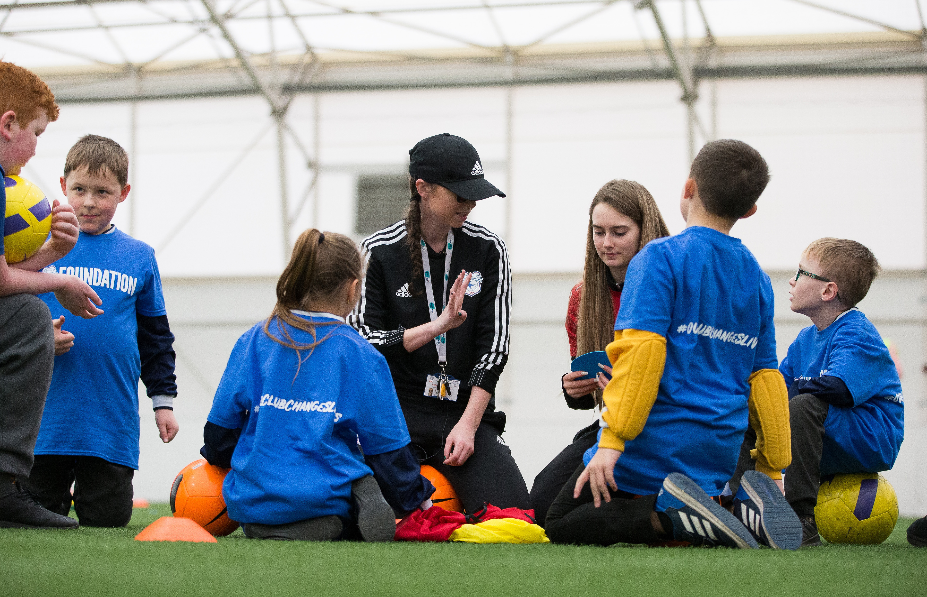
Suggested adaptations
If a new player advises they have ASD, ask them about their condition
Each individual will have differing needs
Routine is often very important, communicate any changes in advance
Set up a ‘safe space’ where players can go if they are feeling overwhelmed

Slide 4

Here is an example of an adapted activity
The game ‘tag’ is often used as a warm-up
Some with ASD will be very sensitive to touch
It might make them anxious or even feel painful
The following video demonstrates inclusive adaptations

Slide 5
Our Adaptations
The playing area is clearly marked with bright, uniformly coloured cones
Give players clear, concise instructions
The ‘tagger’ is given an instruction to start tagging other players
The tagger uses a bib instead of their hands to tag the other players
This is consistent for all players, not just those with sensory issues
All players can enjoy the game without being anxious about their sensory issues

